Slide 1
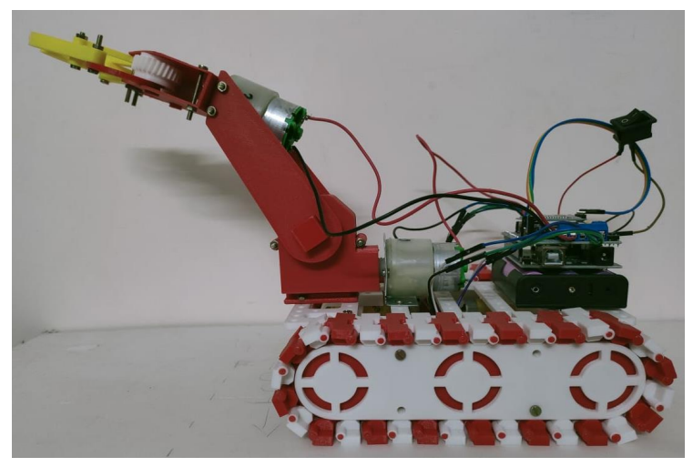
3D PRINTING PICK N PLACE PROJECT

Slide 2
OVERVIEW:
Introduction
Parts of pick n place robot
Working of basic pick n place robot
Circuit connection
Design parts
Advantages
Disadvantages
Practical applications
conclusion

Slide 3
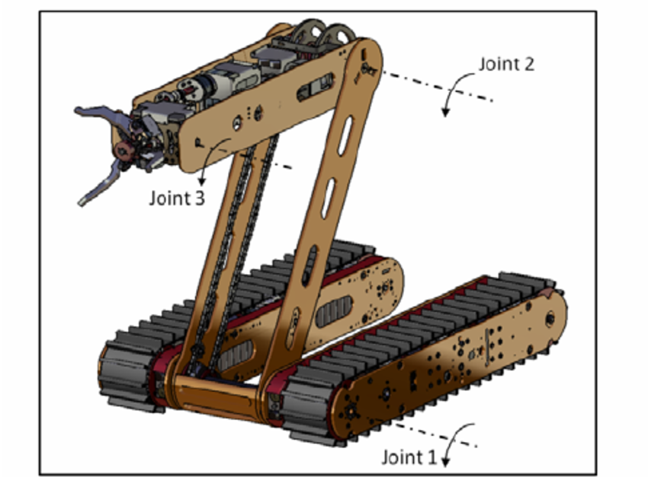
INTRODUTION:
Pick and place robot is the one which is used to pick up and object and place it in desired location . It can be a cylindrical robot providing movement in horizontal , vertical and rotational axis , a spherical robot providing two rotational and one liner movement, an articulate robot or a scara robot (fixed robot with three vertical axis rotary arms).

Slide 4
Parts of a pick n place robot :
Arduino uno
Motor shield
18650 batteries
HC -05 Bluetooth module
Dc gear motors x 4(60 rpm)
Dc gear motors x2(30 rpm)
Wheels x4
On/Off swicth

Slide 5
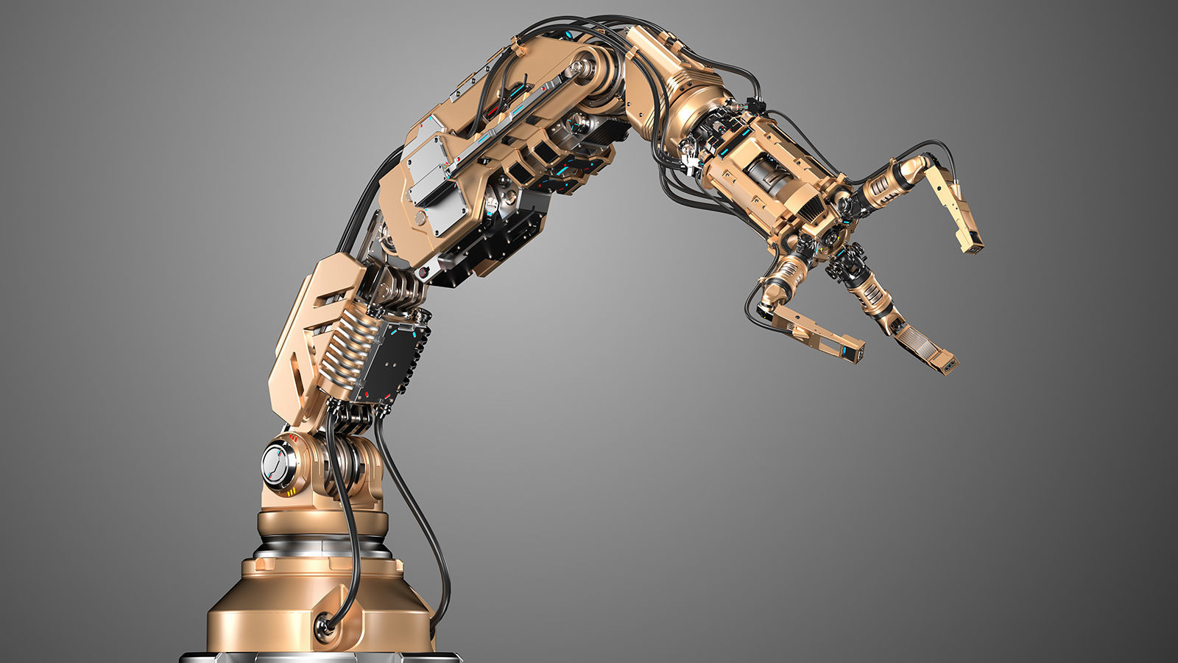
Working of basic pick n place robot
The basic function of a pick and place robot is done by its joints. Joints analogous to human joints and are used to join the two consecutive rigid bodies in the robot they can be rotary joint or linear joint .
To add a joint to any link of a robot ,we need to know about the degrees of freedom and degrees of movement for that body part . Degrees of freedom implement the liner and rotational movement of the body and degrees of movement imply the number of axis the body can move

Slide 6
Working of basic pick n place robot
A simple pick and place robot consist of two rigid bodies on a moving base , connected together with rotatory joints. A rotatory joints is a one which provides rotation in 360 degrees around any one of the axis.
The bottom or the base is attached with wheels which provide linear movement.
The 1st rigid body is fixed and supports the second rigid body to which the end effector is provided.
The 2nd rigid body is provided with movement in all three axis and as 3 degrees of freedom. It is connected to the 1st body with a rotational joint.

Slide 7
Working of basic pick n place robot
The end effector should accommodate all 6 degrees of freedom, in order to reach all sides of the component, to take up position to any height.
On a whole, the basic pick and place robot works as follows:
The wheels underneath the base help to move the robot to the desired location.
The rigid body supporting the end effector bends or straightens up to reach the position where the object is placed .
The end effector picks up the object with a strong grip and places it at the desired position.

Slide 8
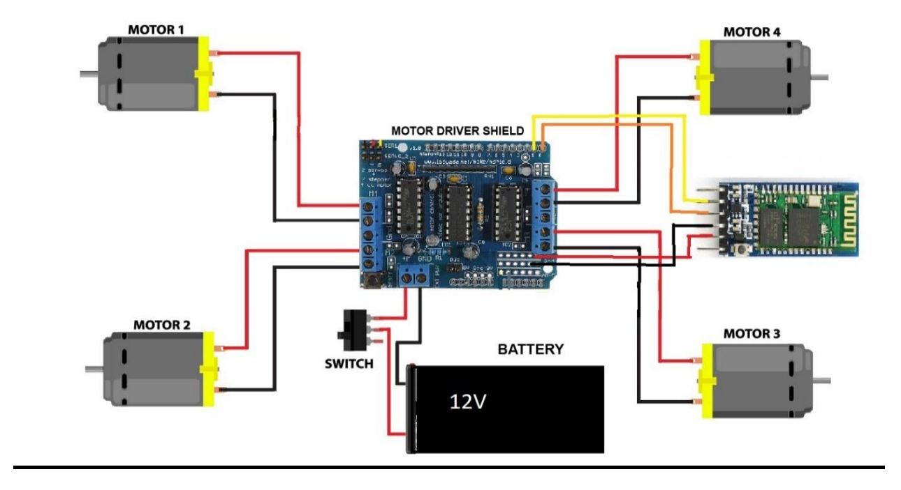
Circuit connection:

Slide 9
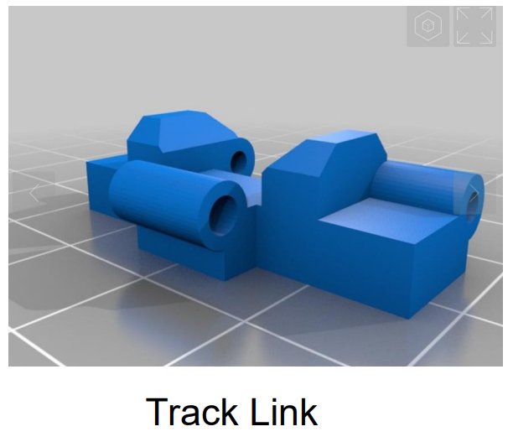
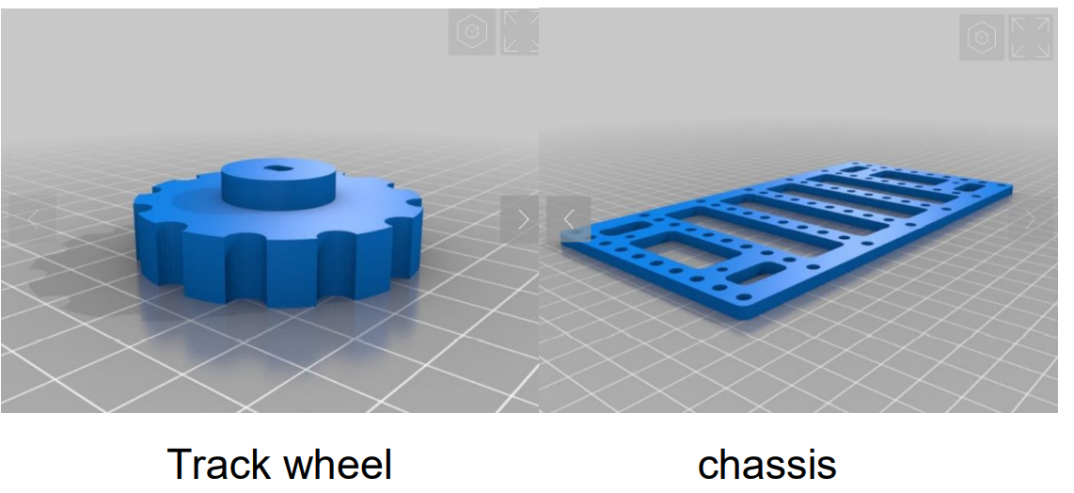
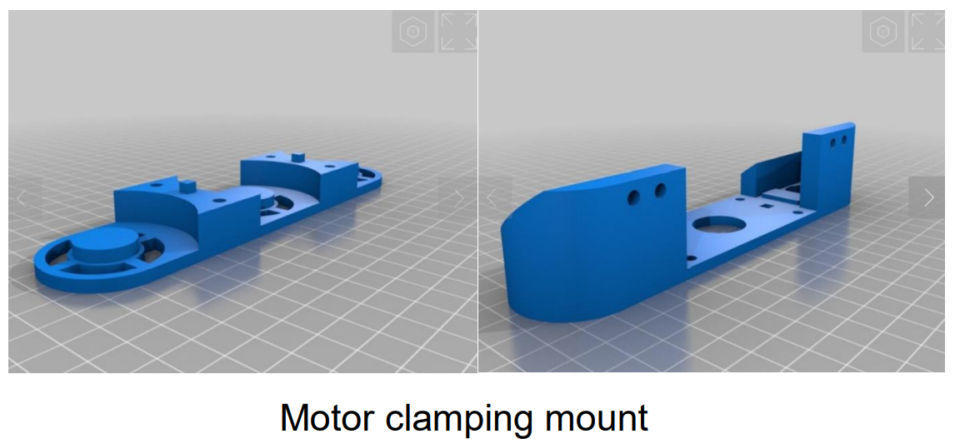
DESIGN PARTS:

Slide 10
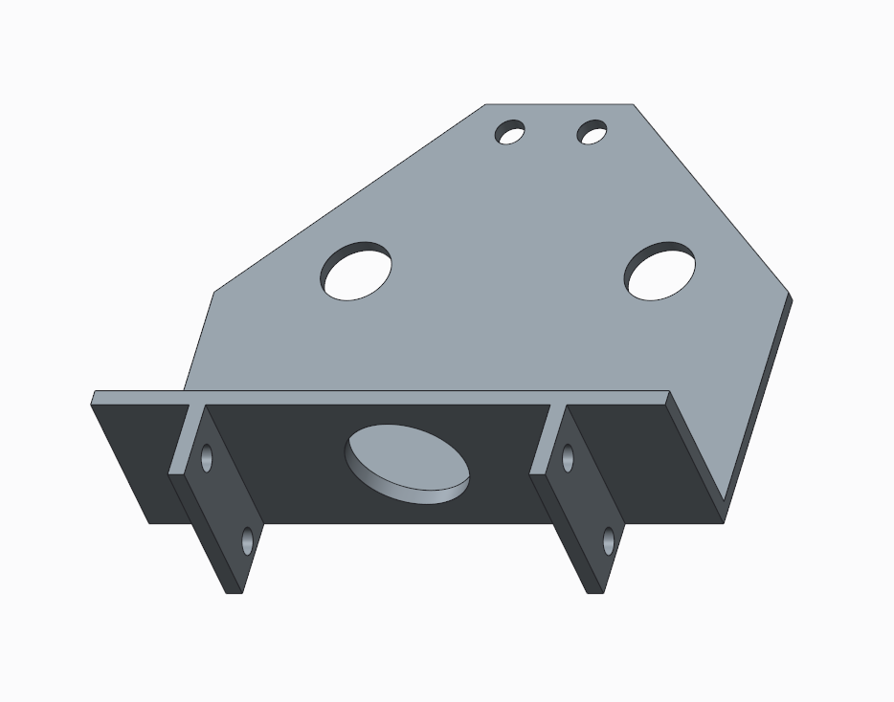
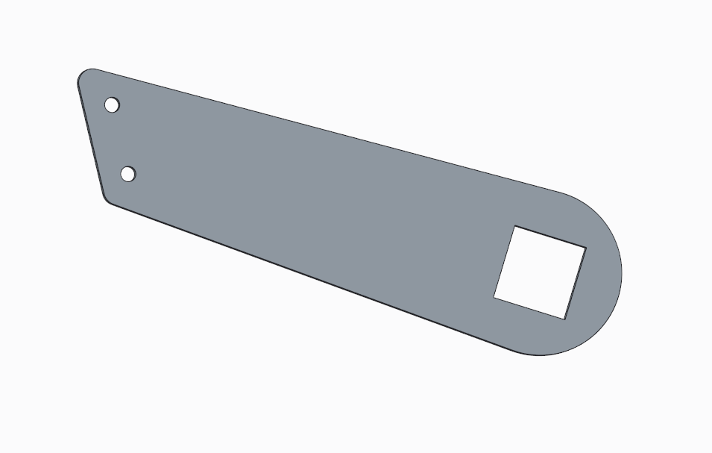
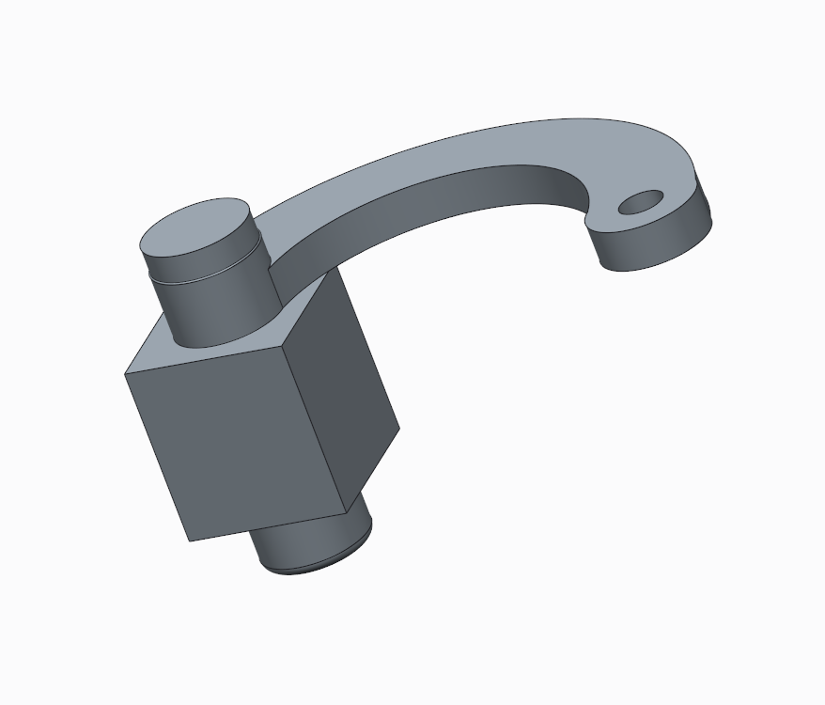
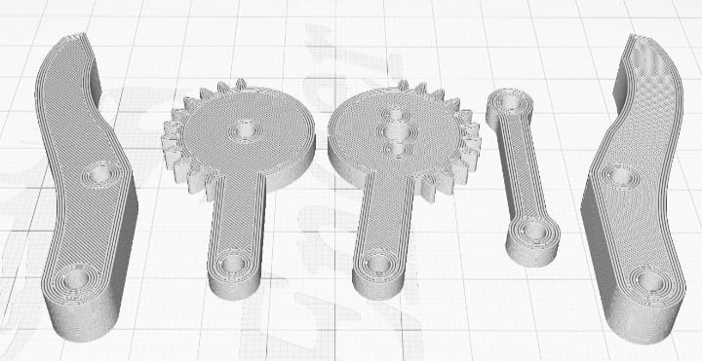
DESIGN PARTS:

Slide 11
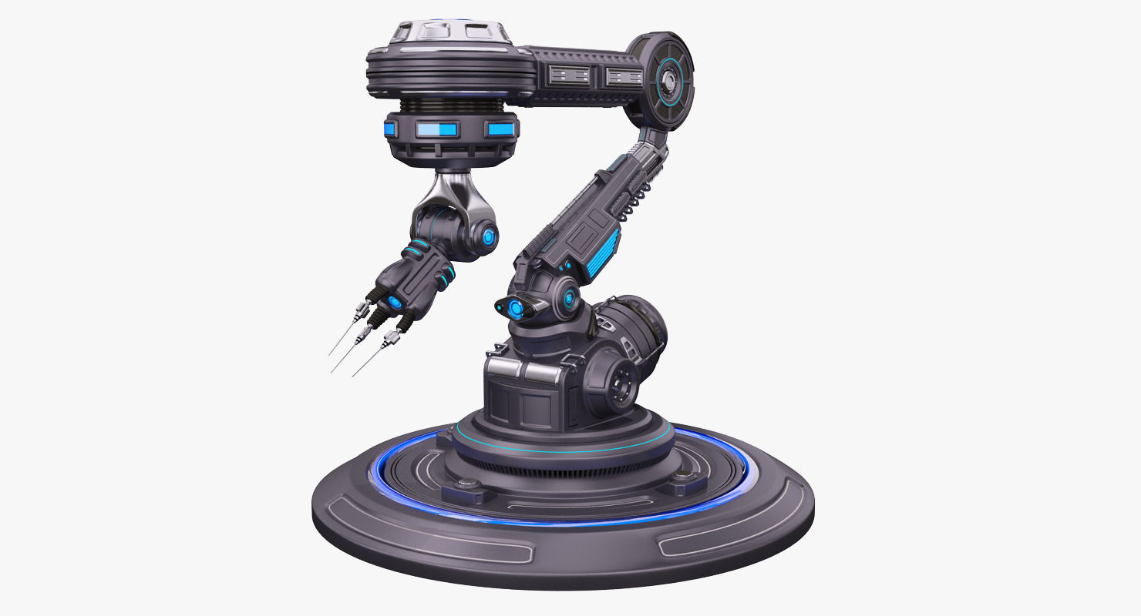
Advantages:
They are faster and can get the work done in seconds compared to their human counterparts .
They are flexible and have the appropriate design.
They are accurate at doing the work given.
They increase the safety of the working environment and actually never get tired.

Slide 12
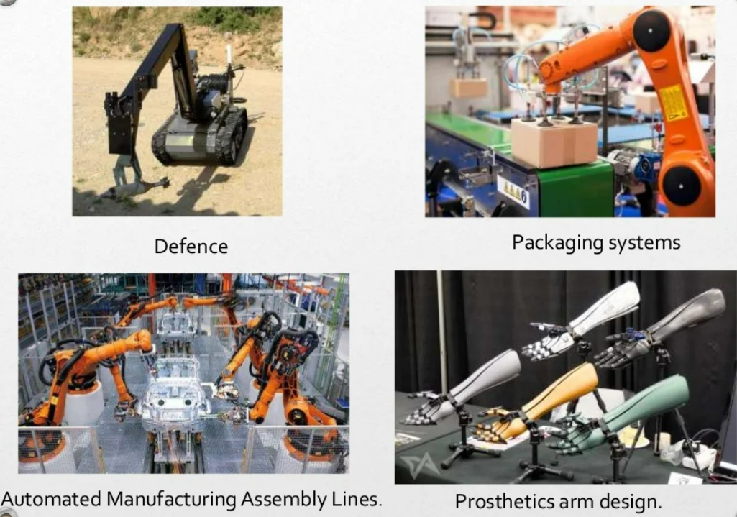

Slide 13
Disadvantages:
1. Expense: The initial investment to integrated automated robotics into your business is significant. Regular maintenance needs can have a financial toll as well.
2. ROI: Incorporating industrial robots does not guarantee results. Without planning, companies can have difficulty achieving their goals.
3. Expertise: Employees will require training program and interact with the new robotic equipment. This normally takes time and financial output.
4. Safety: Robots may protect workers from some hazards, but in the meantime, their very presence can create other safety problems. These new dangers must be taken into consideration.

Slide 14
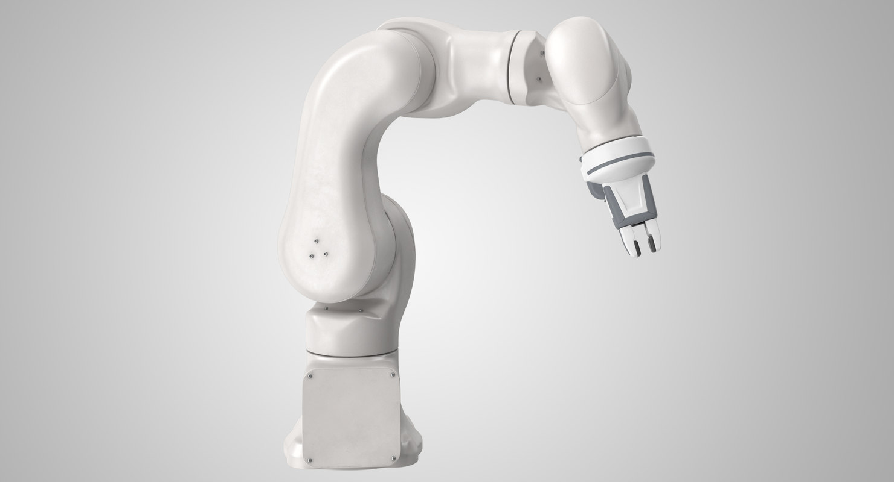
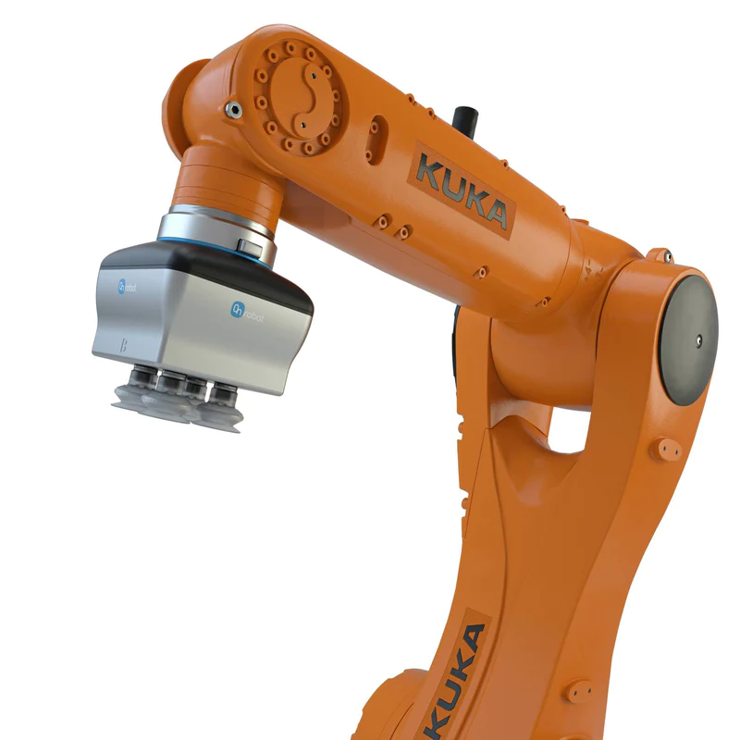
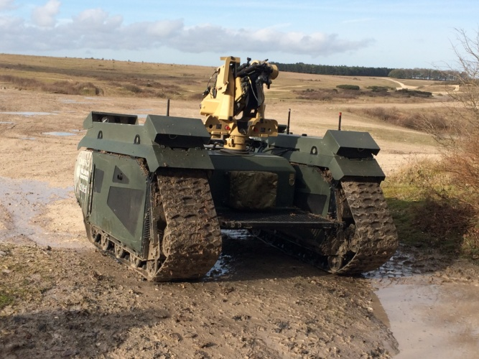
Practical Applications of Pick and Place Robot
Defense Applications: It can be used for surveillance and also to pick up harmful objects like bombs and diffuse them safely .
Industrial Applications: Pick and Place Robots are used in manufacturing, to pick up the required parts and place it in correct position to complete the machinery fixture. It can be also used to place objects on the conveyer belt as well as pick up defective products from the conveyer belt .
Medical Applications: These robots can be used in various surgical operations like in joint replacement operations, orthopaedic and internal surgery operations. It performs the operations with more precision and accuracy.

Slide 15
CONCLUSION:
The prepared mechanism has been successfully constrained and executed to carry out the required work of picking up the weight of the object the table tennis ball and to put them in to the placed at different location
This robot can be modified using some of the latest techniques to make more flexible and addition of movable joints to increase its working capacity

Slide 16

Done By: >A . Vamshi (5D0) >Manish Roy (5G5) >A . Likith (5D1) >M . Mahesh (5G9) >J . Sumed (5F1) >P .Vinay (5H9) >L . Saaketh (5G3)

